Slide 1
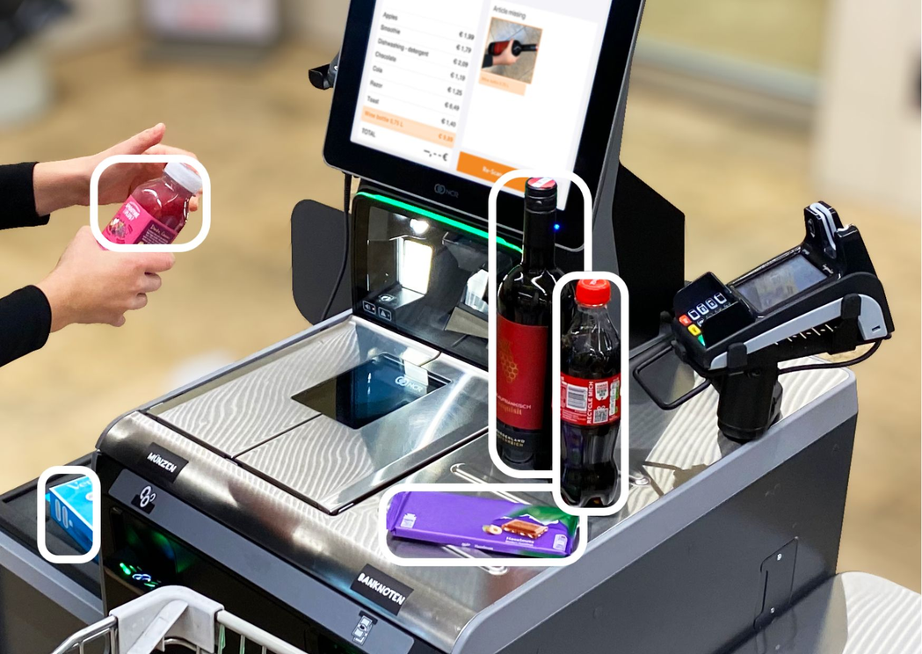
AI Self Checkout System
Real-time retail products detection and billing
Course & Faculty:
CSE468
Dr. Mohammad Shifat-E-Rabbi [MSRb]
Group: 4
Team Members:
Md Rafiqul Islam Rana 2132344642
Mahmudul Hasan Al-amin 2311019042
Omar Ahammed Sakib 2022006042
Shuvra Saha Rimjim 2222483042

Slide 2
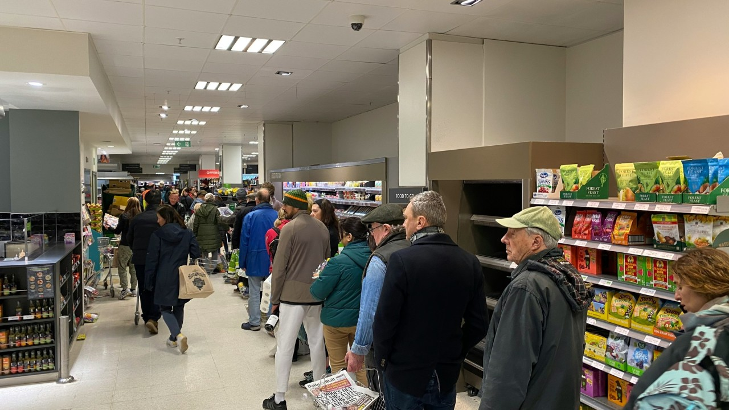
Problem Statement
Traditional checkouts cause long queues
Manual item scanning is slow & error-prone
High staffing costs for cashier roles
Difficult to scale during peak hours
Objectives
Detect items automatically to reduce checkout time & improve efficiency.
Tracks items with IDs to reduce double-billing issues.
Show live receipt overlay on video feed
Should be able to process any standard video source
Group: 4
Mahmudul Hasan Al Amin
Md Rafiqul Islam Rana
Omar Ahammed Sakib
Shuvra Saha Rimjim

Slide 3


YouTube Demo Video :
Group: 4
Mahmudul Hasan Al Amin
Md Rafiqul Islam Rana
Omar Ahammed Sakib
Shuvra Saha Rimjim

Slide 4
SYSTEM ARCHITECTURE/PIPELINE
1
2
3
Video Input
Load frames from
video file
Yolov10x
Detects objects
with conf >= .4
Class filtering
Keeps only the necessary
retail classes
4
5
6
DeepSort
Assigns persistant tractID
to each unique items
Bill Registry
Register unique items once
reduces duplicate billing
Output Render
Bounding Box + Receipt
Overlay on frame
Group: 4
Mahmudul Hasan Al Amin
Md Rafiqul Islam Rana
Omar Ahammed Sakib
Shuvra Saha Rimjim

Slide 5
KEY DESIGN DECISIONS
1
2
3
n_init = 3
max_age = 30
Thread-safe BillState
Object must appear in 3 consecutive frames before billing — reduces false positives
Track kept alive for 30 frames after disappearing — prevents re-billing the same item
Lock-protected registry ensures no race conditions in concurrent frame processing
Group: 4
Mahmudul Hasan Al Amin
Md Rafiqul Islam Rana
Omar Ahammed Sakib
Shuvra Saha Rimjim

Slide 6
CORE COMPONENTS
BillState
Thread-safe registry that maps track IDs to class names. Prevents duplicate billing even when an item lingers across multiple frames.
⟶ Uses threading.Lock() for concurrency safety
FrameLogger
Collects per-frame detection and tracking metrics: raw detections, filtered counts, tracked objects, and confidence scores.
⟶ Exports to a pandas DataFrame for analysis
Group: 4
Mahmudul Hasan Al Amin
Md Rafiqul Islam Rana
Omar Ahammed Sakib
Shuvra Saha Rimjim

Slide 7
Group: 4
Mahmudul Hasan Al Amin
Md Rafiqul Islam Rana
Omar Ahammed Sakib
Shuvra Saha Rimjim
SUPPORTED PRODUCTS & PRICING (BDT)
Total 32 item classes used
Prices in Bangladeshi Taka (BDT)
Based on the COCO dataset categories relevant to retail.
Classes are:
bottle
cup
knife
spoon
bowl
banana
apple
sandwich
tv
laptop
mouse
remote
keyboard
cell phone
microwave
oven
orange
broccoli
carrot
pizza
donut
cake
hair drier
toothbrush
toaster
book
clock
scissors
teddy bear
handbag
tie
sports ball

Slide 8
POST-RUN ANALYSIS & METRICS
Generated Visualizations
Detections per Frame
Raw YOLO vs. class-filtered vs. confirmed DeepSORT tracks over time
Detection Stability
Per-track confidence over frames — measures DeepSORT consistency
Average Confidence per Frame
Rolling confidence with threshold bands (0.4 / 0.5 / 0.75)
Tracking Continuity Table
ID switch rate: unique track IDs vs. actual physical objects
Confidence Distribution
Histogram of all detection confidence scores across the video
Group: 4
Mahmudul Hasan Al Amin
Md Rafiqul Islam Rana
Omar Ahammed Sakib
Shuvra Saha Rimjim

Slide 9
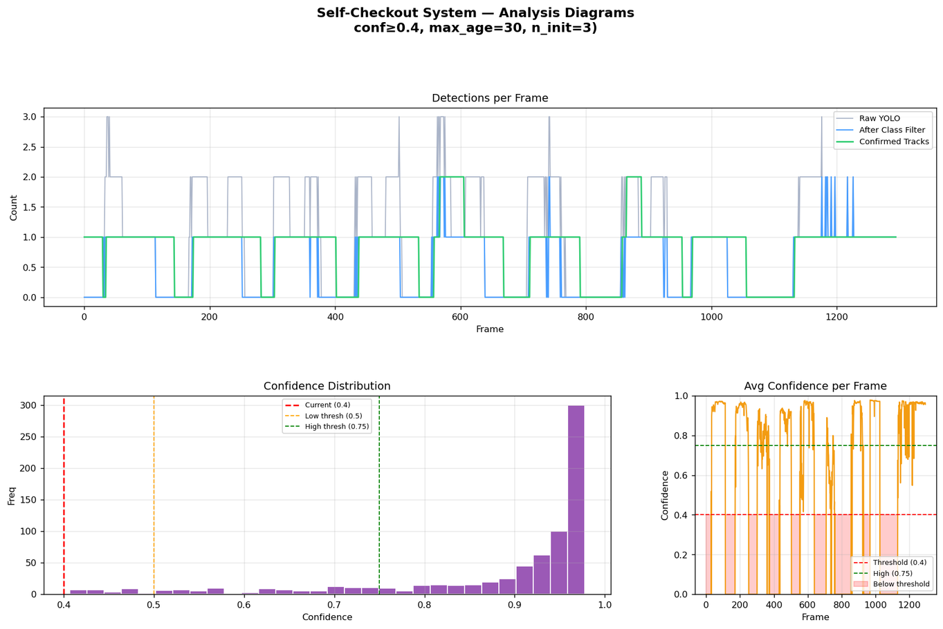
RESULTS & ANALYSIS
Group: 4
Mahmudul Hasan Al Amin
Md Rafiqul Islam Rana
Omar Ahammed Sakib
Shuvra Saha Rimjim

Slide 10
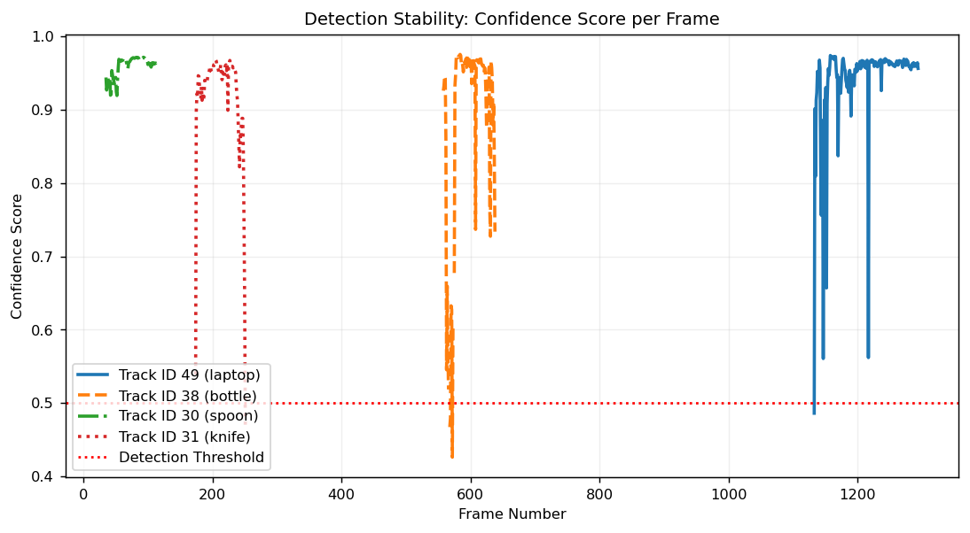
Group: 4
Mahmudul Hasan Al Amin
Md Rafiqul Islam Rana
Omar Ahammed Sakib
Shuvra Saha Rimjim
RESULTS & ANALYSIS

Slide 11
RESULTS & ANALYSIS
Video Summary
Tracking Continuity & Integrity Report
Performance Metric Count
- Video duration (processed): 74.6 s
- Total frames logged: 1295 Average
- processing FPS: 17.4
- Total unique items billed: 12
- Unique product classes: 9
- Mean detection confidence: 0.878
- Detections below 0.50 conf: 3.9%
- YOLO conf threshold used: 0.4
- DeepSORT max_age : 30
- DeepSORT n_init : 3
- Total Detections 745
- Unique Track IDs Assigned 11
- Actual Physical Objects 10
- ID Switches (Tracking Failures) 1
Tracking Error Rate: 10.00%
Group: 4
Mahmudul Hasan Al Amin
Md Rafiqul Islam Rana
Omar Ahammed Sakib
Shuvra Saha Rimjim

Slide 12
Group: 4
Mahmudul Hasan Al Amin
Md Rafiqul Islam Rana
Omar Ahammed Sakib
Shuvra Saha Rimjim
LIMITATIONS:
Detection & Model
The system is constrained to 32 COCO-pretrained classes, which cover only a small fraction of real retail SKUs. Most actual store products (packaged goods, branded items) will go undetected.
YOLOv10x is the largest and most accurate YOLO variant, but it requires significant GPU resources, which isn't ideal for real-time performance.
Items that are partially occluded, stacked, or overlapping may be missed or double-detected.
Tracking & Billing
When two similar-looking items (e.g., two identical cans) pass near each other, ID switches can occur, potentially leading to missed or duplicate billing entries.
Very fast-moving items that appear briefly may never be billed.
The system bills by item class, not by individual SKU or barcode.
System & Infrastructure
Designed and tested exclusively in Google Colab — there is no deployment packaging, REST API, or edge-device support.

Slide 13
Conclusion & Future Work
Expanded Detection
Fine-tune a custom YOLO model on a domain-specific retail dataset.
Add barcode/QR code scanning as a fallback
Explore lighter models (YOLOv10n or YOLOv10s) for edge deployment.
Smarter Tracking & Billing
Introduce weight-sensor fusion
Replace the class-level pricing with SKU-level identification
Robustness & Reliability
Add adaptive confidence thresholding based on the brightness and camera quality.
Build a validation loop that cross-checks billed items against known session entry/exit events to catch ghost detections.
Deployment & Integration
Build a real-time web dashboard (e.g., with FastAPI + WebSockets) that streams the annotated video and live bill to a customer-facing display.
Group: 4
Mahmudul Hasan Al Amin
Md Rafiqul Islam Rana
Omar Ahammed Sakib
Shuvra Saha Rimjim

Slide 14


– Questions?
Group: 4
Mahmudul Hasan Al Amin
Md Rafiqul Islam Rana
Omar Ahammed Sakib
Shuvra Saha Rimjim

